Slide 1
Major Project ,JNCT
Bus Reservation System
Made By
Rishu Kumar Pandey (0131CS191055)
Kunal Sharma (0131CS191036)
Raj Singh (013CS 191053)

Slide 2


1. Intro
It is based 0n Python. Django is a fairly simple system written in Django, SQLLite3, and Python that is intended to automate the purchase of online tickets through an easy online bus booking system. You can manage/book reservations, client info, and passenger lists with the bus ticket reservation system’s Django admin, and book tickets easily via the Bus reservation Website.

Slide 3
What we used to create this project
Python
Django
Sqllite3
Tip
In this example, we’re leading off with something unexpected.
While the audience is trying to come up with a number, we’ll surprise them with the next slide.

Slide 4
Objective
The main objective of the proposed system” Bus Reservation System” is to eliminate the manual reservation system. Making the reservation system, fast, user friendly avoid the unnecessary delay in reservation. The new system needs to develop that can handle lots of records and reports efficiently. Searching information about reservation date etc. will present only on one click.
The systematic approach in running makes the system to work more efficiently.
Various types of constraints can be well interoperated to maintain the database consistency.

Slide 5
Why to use Bus Reservation System
Bus reservation system benefits we can get.
High automation of bus ticket booking
24/7 availability for customers
Instant and contact-free payments
One-click performance analytics

Slide 6
Python version (Recommended) | 3.8 Version | Python 3.8 introduces some new syntax to the language, as well as a few small modifications to existing behavior and, most importantly, a slew of performance improvements, following in the footsteps of the previous 3.7 version.
Programming Language Used | Python Django Language | Django is a high-level Python web framework for building safe and maintainable websites quickly. Django is a web framework built by experienced developers that takes care of a lot of the heavy lifting so you can focus on developing your app instead of reinventing the wheel.
Developer Name | itsourcecode.com | Free projects containing source code in Java, PHP, Python, Django, VB.Net, Visual Basic, C, C++, C#, Javascript, and other languages are available on this website.
IDE Tool (Recommended) | Sublime, Visual Studio, PyCharm | Sublime Text is a source code editor that is available for purchase. It comes with built-in support for a variety of programming and markup languages. Plugins, which are often community-built and maintained under free-software licenses, allow users to extend the functionality of the system. Sublime Text has a Python API to help with plugins.
Project Type | Web Application | A web application, unlike computer-based software programs that operate locally on the device’s operating system, is application software that runs on a web server. The user uses a web browser with an active network connection to access web apps.
Database | SQLite | SQLite is a programming language that is used to create embedded software for devices such as televisions, cell phones, and cameras. It can handle HTTP requests with low to medium traffic. SQLite has the ability to compress files into smaller bundles with less metadata. SQLite is a temporary dataset that is used within an application to process data.

Slide 7
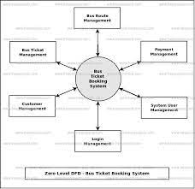

Slide 8
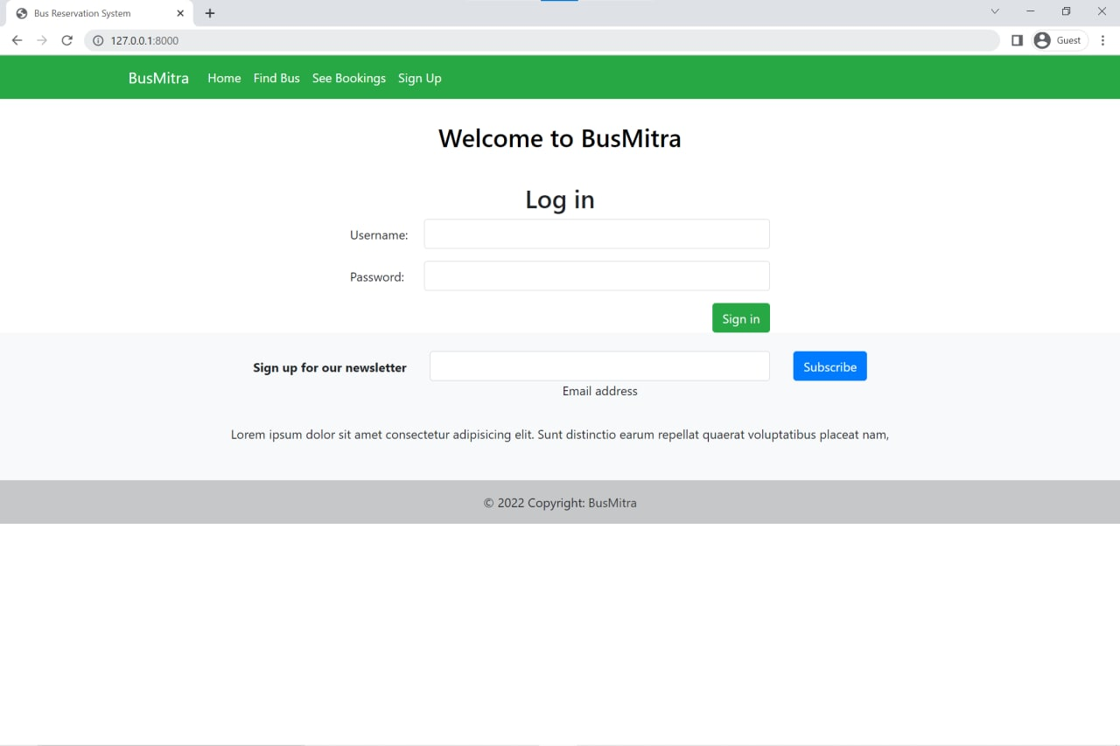

Slide 9
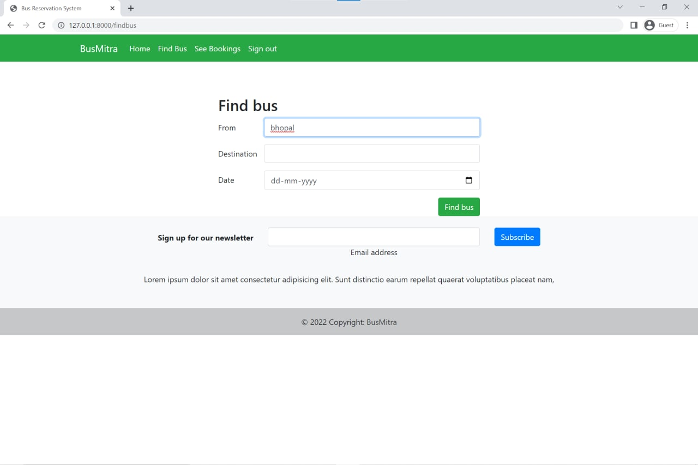
Know a 2nd language? Make Google Translate even better by joining the community.
Tip
Inspire your audience to act on the information they just learned.
Depending on your idea, this can be anything from downloading an app to joining an organization.

Slide 10
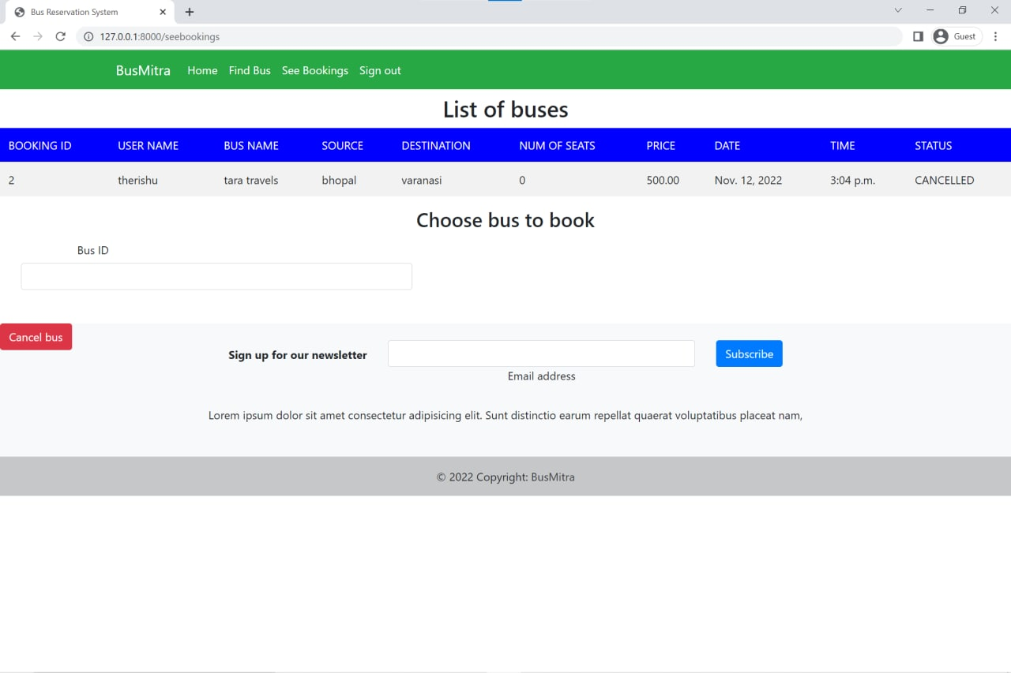

Slide 11
SUMMARY
In 1974, American airlines were the first to use an automated booking system, which was still almost manual. Technology grew, and a computer reservation system was developed. In this present era, the online booking or reservation system has improved the operations of various sectors of a nation’s economy deploying this system. Online Bus Ticket Reservation System being a web based system that ensures that the company would be able to transform most of the processes carried out manually into automated, error-free and easy to use operations in the organization especially in the area of transportation;
also it would be able to generate reports for the management decision purpose. This system will be developed using a waterfall methodology for research and design purposes, PHP as the programming language because of its server-side processing capabilities that makes data process less on the client personal computer, an implementation strategy as well as testing and maintenance strategies suitable for efficient deployment of the system.But we used python cause its better an have more better framework.

Slide 12
Conclusion
It can be observed that computer applications are very important in every field of human endeavor. Here all the information about customer that made reservation can be gotten just by clicking a button with this new system, some of the difficulties encountered with the manual system are overcome. It will also reduce the workload of the staff, reduce the time used for making reservation at the bus terminal and also increase efficiency. The application also has the ability to update records in various files automatically thereby relieving the company’s staff the stress of working from file security of data,
This project, as a whole, will give a new way in bus reservations and ticketing processes. The automation and management of seats and reservations will be done online. However, this project does not limit the walk-in passengers that is passengers who visit the company’s counter because it also caters for them. This also lessens the use of papers like in the traditional way of ticketing.

Slide 13

Thank YOU!
We hope you’ll use these tips to go out and deliver a memorable pitch for your product or service!

